Slide 1
Grocery Recommendation System
Presented by Jason Caldwell

Slide 2
Executive Summary
Recommendation systems help increase sales and improve customer satisfaction.
Evaluated multiple machine learning models using:
simple means,
various custom similarity functions, and
hybrid approaches.
Combining content-based and collaborative filtering achieved the best results.
F1-score: 85%

Slide 3
Recommender Systems ¹
What are they?
Machine learning models / AI algorithms
Use Big Data
Suggest additional products to consumers
Benefits
Improve customer retention
Increase sales
Form habits

Slide 4
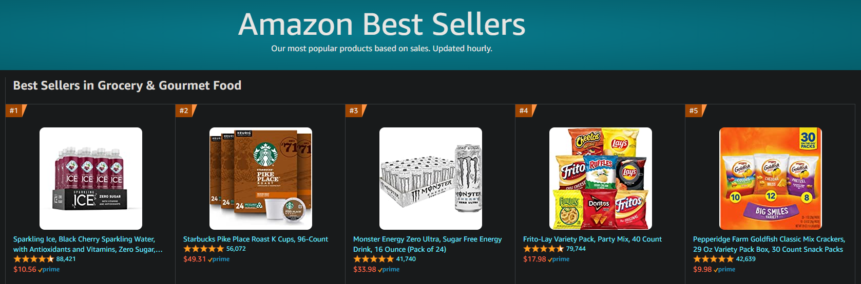
Amazon ¹
Generates 35% of revenue from recommendation systems.
In 2016, yearly sales volume was 135.99 billion.

Slide 5
Project Scope
Companies use many types of recommendation systems.
This project analyzed:
Hard-coded baselines
Simple means
Content-based filtering
Collaborative filtering
Custom similarity functions
Hybrid of the above

Slide 6
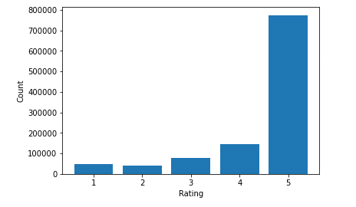
Data Wrangling
Merged 2 different datasets
Ended up with 15 columns with 149k to 1.1 million rows
Target feature is ‘overall’; which is the rating of the product

Slide 7
Exploratory Data Analysis
Features | Number of Categories
reviewerID | 127,496
asin | 41,280
rank | 36,865
also_buy | 29,115
style | 27,490
also_view | 21,871
brand | 8,861
3 numeric and 1 boolean feature
All had skewed distributions
Majority of features were objects / categories
Sample shown right

Slide 8
Preprocessing and Training
80 / 20 train / test split
Adjusted several parts of the original plan by now
Used only a subset of data going forward
Issues:
Memory
Processing Time
Code refactoring

Slide 9
Evaluating Models
Root Mean Square Error (RMSE) for all model versions
measures the average magnitude of the error
very easy to differentiate
gives a relatively high weight to large errors
Notes:
Can use with derivative-based methods such as gradient descent.

Slide 10
Baseline - Version 0
In the real world, would usually use the company's previously collected data and customer information.
Hard coded various ratings for all recommendations
A value of 4 had best results
RMSE of 1.1813
Want all future models to improve upon this

Slide 11
Simple Mean - Version 1
Collaborative mean - average of users
Content mean - average of products
Collaborative mean was best with RMSE of 1.5540
However, these were the worst performing models

Slide 12
Similarity Functions - Version 2
Included calculations:
Pearson
Euclidean
Best RMSE of 1.2234
Cosine
Jaccard
In all cases, they were:
very close to one another
better than v1
worse than the best baseline

Slide 13
Hybrid Model - Version 3
Combined both content-based and collaborative filtering.
During training, the RMSE was 0.2027
During testing, the RMSE was 1.1413
Results show there was an issue with overfitting
Was the best overall model

Slide 14
Version 3.1
Returned just 10 random samples
Only included predicted 5-star recommendations
Added additional evaluation metrics:
Accuracy: 60-90%
Best weighted averages were:
Precision: 0.81
Recall: 0.90
F1-score: 0.85
Notes:
F1-score is good for uneven class distribution

Slide 15
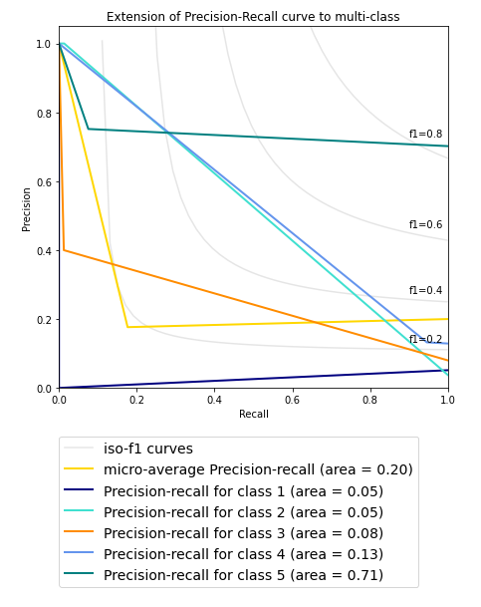
Evaluation of v_3.1
Metrics were good for 5-star ratings
Not so good for the others
Lesson learned:
should have downsampled 5-star
or upsampled others
Notes:
Switched to use precision-recall curve instead of ROC-curve because of uneven class distribution
.

Slide 16
Additions to Project
Created unit and integration tests.
Provided log results to assist with data cleaning and troubleshooting.
Added .env and environment_example.txt files.
Refactored course example tutorial from Python 2 to Python 3.
Involved updating a lot of deprecated code and re-writing functions and classes.

Slide 17
Biggest Challenges
Limiting the scope by:
analyzing just grocery data, and
evaluating only the recommendation models listed above.
More data cleaning was needed than was originally expected.
Updating the sample code to use more recent examples and modules.
The amount of processing time and resources needed to train and analyze the models.

Slide 18
Possible Future Next Steps
Create a newer version 4 using Pyspark.
Use parallel processing and cloud computing.
Build upon version 3.1 results.
Train on more data.
Deploy into production.
Faster prediction times (almost real-time vs batch).
Perform A/B testing to quantify the recommendations value.
Adjust to new data, the user’s behavior, and purchases over time.

Slide 19
Summary
Recommendation systems improve customer retention, increase sales, and help form customer habits.
A hybrid model using both content-based and collaborative filtering provided the best recommendations:
Accuracy: 0.90
Precision: 0.81
Recall: 0.90
F1-score: 0.85

Slide 20
Questions?
References
Jianmo Ni (2018). Amazon Review Data (2018).
Muffaddal Qutbuddin (2020). An Exhaustive List of Methods to Evaluate Recommender Systems.
Rumi Olsen (2018). Call an Amazon SageMaker model endpoint using Amazon API Gateway and AWS Lambda.
Scikit Learn 0.24.2 (2021). Precision-Recall.
Sigmoidal.io (2017). AI & Machine Learning Consulting. Recommendation Systems - How Companies are Making Money.
Tomáš Řehořek (2016). Evaluating Recommender Systems: Choosing the best one for your business.
Unata (2015). Hands-on with PyData: How to Build a Minimal Recommendation Engine.

